Slide 1
Getting in Your Robot’s Head
Building Mental Models of Robots Using Human-Concept Learning
Notes:
Welcome to my thesis presentation – Getting in Your Robot’s Head: Building Mental Models of Robots using Human-Concept Learning.

Slide 2
Table of Contents
01
02
03
04
Problem & Research Questions
Overview and why should we care
Background
Previous related work
Experiment
Overview of experimental methods
Results
Discussion of results

Slide 3


01
Problem
?
Overview of research questions and motivations
Notes:
So – what is this thesis about?
To collaborate effectively and safely with machine partners, it is essential to understand and be able to predict how they will behave.
This thesis explores how using variation theory [1], a human-concept learning theory from cognitive science, to select training demonstrations of agent behavior impacts people’s understanding of how the agent will act.
By helping people improve their mental model of the artificial agents they interact with, the goal is to improve people’s ability to predict their particular machine’s behavior.

Slide 4
What is the problem?
Notes:
So what is the problem?
As we interact in the world with people or agents, we rely on models we have developed of how people are likely to behave to predict their future behavior.
Consider the case of attempting to navigate a hallway – most of the time it works without conscious thought, but sometimes you are unable to predict the other person’s behavior and so end up wasting time as each person attempts to move to a different side. This is an example of an incorrect mental model leading to a poor prediction until the mental models converge and each person is on a different side of the hallway by predicting the other person’s motion.
That inefficiency is expensive and time-consuming, while trying to move without a good understanding makes a possible collision a result. That would make it unsafe.
In the case of robots, to be able to interact in the same environments, we need to be able to predict their behavior by generating correct mental models of them.

Slide 5
What is the problem?
Notes:
So what is the problem?
As we interact in the world with people or agents, we rely on models we have developed of how people are likely to behave to predict their future behavior.
Consider the case of attempting to navigate a hallway – most of the time it works without conscious thought, but sometimes you are unable to predict the other person’s behavior and so end up wasting time as each person attempts to move to a different side. This is an example of an incorrect mental model leading to a poor prediction until the mental models converge and each person is on a different side of the hallway by predicting the other person’s motion.
That inefficiency is expensive and time-consuming, while trying to move without a good understanding makes a possible collision a result. That would make it unsafe.
In the case of robots, to be able to interact in the same environments, we need to be able to predict their behavior by generating correct mental models of them.

Slide 6
What is the problem?
Notes:
So what is the problem?
As we interact in the world with people or agents, we rely on models we have developed of how people are likely to behave to predict their future behavior.
Consider the case of attempting to navigate a hallway – most of the time it works without conscious thought, but sometimes you are unable to predict the other person’s behavior and so end up wasting time as each person attempts to move to a different side. This is an example of an incorrect mental model leading to a poor prediction until the mental models converge and each person is on a different side of the hallway by predicting the other person’s motion.
That inefficiency is expensive and time-consuming, while trying to move without a good understanding makes a possible collision a result. That would make it unsafe.
In the case of robots, to be able to interact in the same environments, we need to be able to predict their behavior by generating correct mental models of them.

Slide 7
What is the problem?
Notes:
So what is the problem?
As we interact in the world with people or agents, we rely on models we have developed of how people are likely to behave to predict their future behavior.
Consider the case of attempting to navigate a hallway – most of the time it works without conscious thought, but sometimes you are unable to predict the other person’s behavior and so end up wasting time as each person attempts to move to a different side. This is an example of an incorrect mental model leading to a poor prediction until the mental models converge and each person is on a different side of the hallway by predicting the other person’s motion.
That inefficiency is expensive and time-consuming, while trying to move without a good understanding makes a possible collision a result. That would make it unsafe.
In the case of robots, to be able to interact in the same environments, we need to be able to predict their behavior by generating correct mental models of them.

Slide 8
What is the problem?
Notes:
So what is the problem?
As we interact in the world with people or agents, we rely on models we have developed of how people are likely to behave to predict their future behavior.
Consider the case of attempting to navigate a hallway – most of the time it works without conscious thought, but sometimes you are unable to predict the other person’s behavior and so end up wasting time as each person attempts to move to a different side. This is an example of an incorrect mental model leading to a poor prediction until the mental models converge and each person is on a different side of the hallway by predicting the other person’s motion.
That inefficiency is expensive and time-consuming, while trying to move without a good understanding makes a possible collision a result. That would make it unsafe.
In the case of robots, to be able to interact in the same environments, we need to be able to predict their behavior by generating correct mental models of them.

Slide 9
Variation Theory Applied to Agents
1. Familiarization
2. Contrast
3. Generalization
4. Fusion
Repetition of the agent in an environment
Vary agent but environment stays the same
Vary environment but agent stays same
All vary
[1] F. Marton, Necessary conditions of learning. Routledge., 2014.
Notes:
In my research, I attempt to address this issue of model mismatch before any possible conflict by correcting people’s initial instinctual model rather than changing the robot’s behavior. To do this, I propose to use variation theory from cognitive science, as introduced by Ference Marton [1], to form a teaching intervention which takes place without any need for interaction between the human and the agent to occur before hand.
Variation theory is a long-used theory in classroom settings with the goal of teaching people to learn new concepts by a sequence of steps taking people from discovering what the concept is to being able to use the concept in new environments. It argues that all concepts can be broken down into critical aspects – for instance, in recognizing something, one of those critical aspects might be color.
To best teach people a concept, variation theory proposes a teaching method composed of four steps in sequence: familiarization, contrast, generalization, and fusion [1]. This tries to help people find the critical aspect – that is the particular thing we are trying to teach people.
Here, I am going to describe the steps of variation theory as I operationalized them for use in the robots setting – variation theory is much more general and can be applied across settings.
In this example, imagine you’ve never known the idea of the color purple. Here, the critical aspect is the color purple.
Familiarization repeats the agent in the environment – helping find what the critical aspect is. We notice that there is something similar about this purple color between the examples.
Contrast varies the agent while the environment stays the same – showing differences in the critical aspect. Here we find out that it is the color that matters, not any of the other features. We can find out when purple is no longer purple and turns to a different color.
Generalization varies the environment while the agent stays the same – showing what the critical aspect isn’t. Here we see that the background of the purple doesn’t matter.
Fusion mimics real life, so all vary

Slide 10
How should we apply this theory in our domain?
Notes:
Our next question, therefore, is how can we apply this theory to the domain of robotics?

Slide 11
02
Background
Prior work

Slide 12
Why do we need to predict what agents will do?
[10] P. A. Lasota and J. A. Shah, “Analyzing the effects of human-aware motion planning on close-proximity human–robot collaboration,” Human Factors, vol. 57, no. 1, pp. 21–33, 2015. PMID: 25790568.
[13] S. Nikolaidis, P. Lasota, R. Ramakrishnan, and J. Shah, “Improved human–robot team performance through cross-training, an approach inspired by human team training practices,” The International Journal of Robotics Research, vol. 34, no. 14, pp. 1711–1730, 2015.
Notes:
Much prior work [10], [11] has been done to try to help robots predict what people will do and adapt to that, but this work instead focuses on the inverse – how can we help people predict what robotic agents will do?
The necessity of predictable robot motion is well-attested to in papers like Lasota et al. in “Analyzing the effects of human-aware motion planning on close-proximity human–robot collaboration”
Nikolaidis et al. [13] similarly argue in ”Improved human–robot team performance through cross-training, an approach inspired by human team training practices” that effective collaboration is based on human-robot mental model similarity.
The issue is that not all agent behavior is predictable initially.

Slide 13
Prior Work on Familiarization
Motion becomes more predictable with familiarization
Issue: not all robot behavior is predictable initially.
  Limited effectiveness for unnatural motion
[14] A. D. Dragan and S. S. Srinivasa, “Familiarization to robot motion,” in 2014 9th ACM/IEEE International Conference on Human-Robot Interaction (HRI), pp. 366–373, 2014.
Notes:
Although it doesn’t specifically use the language of variation theory, Dragan and Srinivasa’s prior work on familiarization, ”Familiarization to Robot Motion”, [14] addresses the benefits of using the first step of variation theory to see if motion becomes more predictable after people are trained with familiarization.
Their study featured a robot reaching its arm toward an object on a table. Participants were trained by showing multiple examples of the robot moving. Users were tested, both with seen scenarios and unseen new situations, to see if they could correctly identify the actual motion out of several possible motion options.
However, Dragan and Srinivasa’s work shows that not all robot or agent behavior is predictable, even after training with familiarization which is the current standard used in people’s teaching about robots. Though it does improve predictability, it did not give users the complete ability to predict robot behavior and was less effective on motion that was unnatural.
This thesis tries to find more effective ways to train people to understand agent behavior than the usual “show many examples” technique.

Slide 14
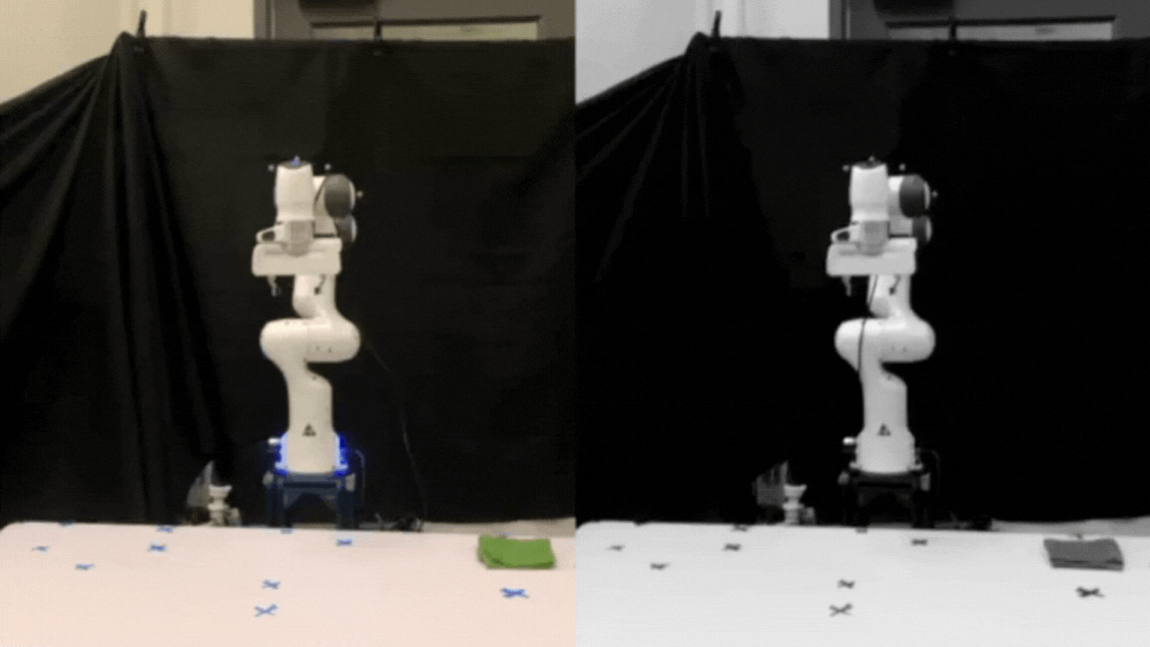
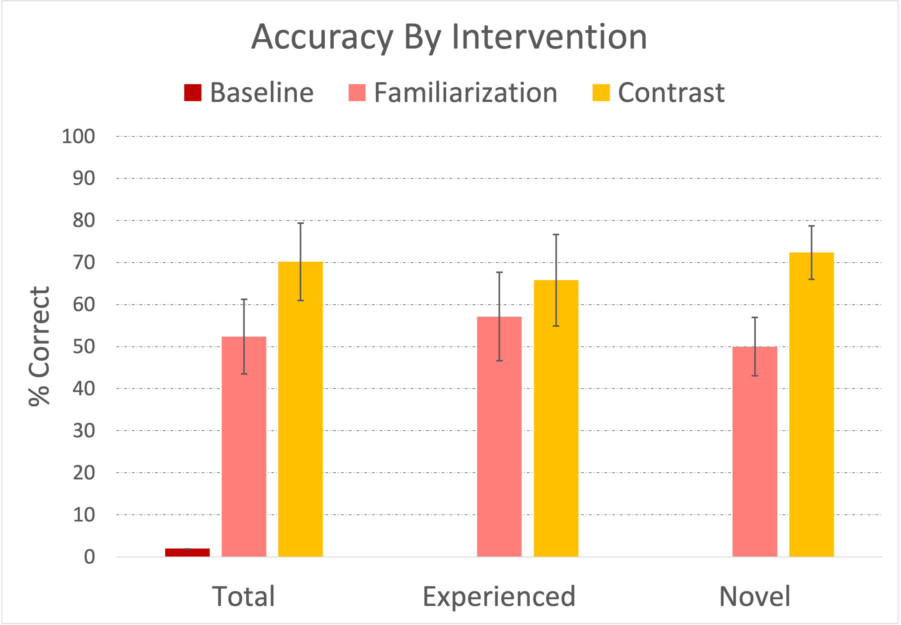
Prior Work
[2] T. Horter, E. L. Glassman, J. Shah, and S. Booth, “Varying how we teach: Adding contrast helps humans learn about robot motions,” in HRI Workshop on Human-Interactive Robot Learning, 2023.
Notes:
In my own prior work [2], I’ve tested the contrast step of variation theory.
I developed that study based on the previously mentioned work of Dragan and Srinivasa testing the impact of familiarization. The experimental setup is inspired by their work and uses a similar testing scheme of a reach toward an object on the table with training videos beforehand and then six testing scenarios (4 unseen, 2 seen).
The contrast videos showed the same scenario as the familiarization (a robot arm reaching to the same place on the table) but they were shown side-by-side with a contrasting video of the same scenario where the robot followed a different policy of motion.
However, this time, I decided to use unnatural motion (the arm moving jointwise) as the policy to learn in order to test the limits of familiarization and see if contrast would improve on that baseline.
Overall, while not statistically significant, the use of contrast did improve people’s understanding. And, contrast significantly helped people’s prediction ability in unseen scenarios.

Slide 15
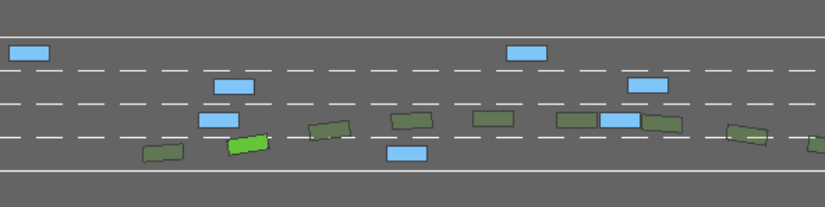
Setting
The highway environment for a self-driving car (green) surrounded by other cars (blue)
[3] E. Leurent, “An environment for autonomous driving decision-making.” https://github.com/eleurent/highway-env, 2018.
Notes:
The main idea of this study is to apply variation theory techniques to allow people to better predict agent behavior.
As I’m interested in the domain of self-driving cars, I’m testing this in a new domain of a self-driving car simulator. This simulator is also commonly used in the literature of RLHF – reinforcement learning from human feedback. This means that the variation theory techniques will be tested on machine learning agents rather than on physical robots.

Slide 16
To what extent does the use of variation theory teach humans to predict agent behavior in self-driving?
Notes:
The overarching research question of this work is: to what extent does the use of variation theory teach humans to predict agent behavior in self-driving?
One way to test this is to examine the accuracy of people’s prediction of the agent’s behavior.

Slide 17
Hypothesis 1
Using the prescribed steps of variation theory will improve users’ ability to predict an agent’s behavior, particularly in unseen environments.
[2] T. Horter, E. L. Glassman, J. Shah, and S. Booth, “Varying how we teach: Adding contrast helps humans learn about robot motions,” in HRI Workshop on Human-Interactive Robot Learning, 2023.
Notes:
Read hypothesis
Based on my prior study [2], I predict that, since contrast in the domain of robot motion improved user’s ability to predict agent behavior in unseen environments, that contrast, generalization, and particularly the combination of steps will improve predictions from the baseline of familiarization. As variation theory is supposed to build people's ability to identify the concept in new scenarios by forming concept boundaries, the combination should improve prediction ability.

Slide 18
Hypothesis 2
Policies that deviate from typical human driving behaviors will be harder for people to learn.
[17] M. Bassok, Analogical Transfer in Problem Solving, p. 343–370. Cambridge University Press, 2003.
[14] A. D. Dragan and S. S. Srinivasa, “Familiarization to robot motion,” in 2014 9th ACM/IEEE International Conference on Human-Robot Interaction (HRI), pp. 366–373, 2014.
Notes:
I hypothesize that certain policies may be harder to learn - one suspicion is that policies that are different from typical driving behaviors will be harder for people to learn as subjects will enter the learning environment with a pre-learned bias against such behaviors that has been trained for years in the American car-based society.
Analogical transfer theory [17] is an idea from cognitive science that people apply their previously acquired knowledge from a different scenario, the “base” scenario, onto the current scenario, the “target problem”. Though the environments of a self-driving car and a car with a human driving may appear similar, it is possible that they may be considering different types of input and so may react in different ways. This raises the issue of “negative transfer” [17] where the base and the target are not in fact aligned, possibly leading to an incorrect solution.
This may reflect the same issue that Dragan and Srinivasa brought up in “Familiarization to Robot Motion” [14] – that there are limits to the amount that familiarization can help generate predictable motion but is limited to motion that is fairly natural. However, I hypothesized that variation theory will help overcome this prior compared to familiarization alone.

Slide 19
Hypothesis 3
Participants trained using the prescribed steps of variation theory will have a higher trust in the agent.
[5] J. D. Lee and K. A. See, “Trust in automation: Designing for appropriate reliance,” Human Factors, vol. 46, no. 1, pp. 50–80, 2004. PMID: 15151155.
[14] A. D. Dragan and S. S. Srinivasa, “Familiarization to robot motion,” in 2014 9th ACM/IEEE International Conference on Human-Robot Interaction (HRI), pp. 366–373, 2014.
Notes:
Read hypothesis
Another interesting question to consider is whether this training will improve people’s trust in the agent. As Lee and See, in their seminal work on trust in automation [5], define trust as partly based in believing that “an agent will help achieve an individual’s goal in a situation,” I suspect that in this study, trust will increase as predictability of the motion increases, as Dragan and Srinivasa observed in their familiarization study [14].
However, pure increase of trust is not necessarily a good thing – as Lee and See [5] note, the goal should be “calibrated trust” where trust in the system corresponds to the capabilities of the system. Increased trust generated by training without increased actual understanding could be dangerous and cause overtrust.

Slide 20
03
Experiment
Overview of experimental methods
Notes:
So, how do we test these hypotheses?

Slide 21
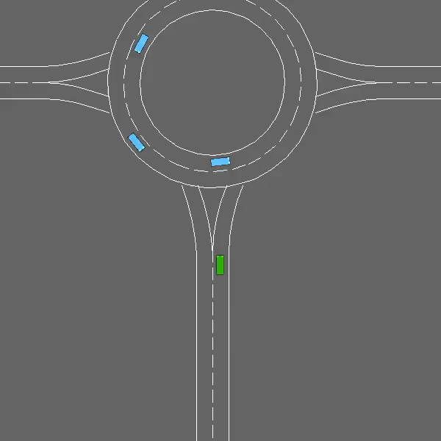
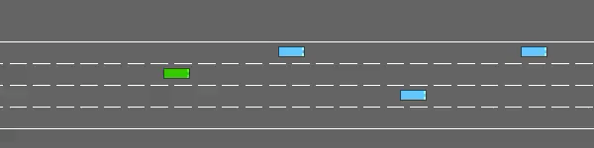
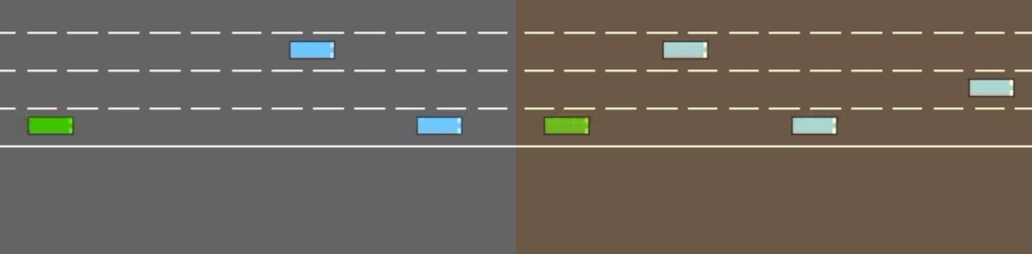
Experimental Idea
Familiarization
Contrast
Generalization
Repetition of the agent in an environment
Vary agent but environment stays the same
Vary environment but agent stays same
Combined
Notes:
So, the first three steps of variation were tested to determine which steps are most beneficial to human’s learning of an agent’s behavior in a self-driving domain. To test differences in participants’ ability to predict across these different teaching methods, a user study was run to establish the efficacy of each method by using each method to train different people on various policies of a self-driving car’s motion in a between-subjects design.
I designed interventions for each of the first three phases of variation theory, as well as a structured combination of the phases, then tested them in a fusion setting.

Slide 22
Training Phase: Familiarization
Familiarization
Repetition of the agent in an environment
Notes:
In the familiarization step, participants are shown multiple videos of the agent moving through the same kind of environment, centering for the participant the agent’s movement as the essential feature.

Slide 23
Training Phase: Contrast
Contrast
Vary agent but environment stays the same
Notes:
For the contrast step, the same videos are shown next to videos of alternate policies (such as avoiding other cars) responding to the same environmental input. This helps establish the policy’s concept boundaries by showing what possible kinds of actions the agent would not take.

Slide 24
Training Phase: Generalization
Generalization
Vary environment but agent stays same
Notes:
The generalization step exposes participants to different possible environments that an agent with the same policy might act in (for example, a highway on-ramp), pointing the participant to features of the given policy that are unchanging regardless of the environment. This allows people to broaden their understanding of the policy in unseen scenarios.

Slide 25
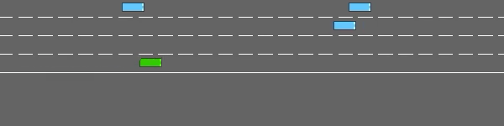
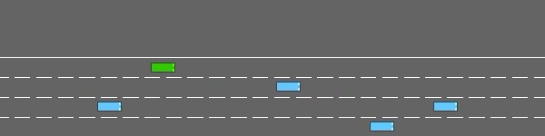
Training Phase Policies
SocialDistance
Maximize total distance from other cars
FastRight
Parallel
Move as quickly as possible (within a speed limit) in the right lane
Stay as close as possible in the x-direction to a car that isn’t in its lane
Notes:
Each condition was split into 3 groups which experienced different policies.
Read FastRight, SocialDistance and Parallel policies

Slide 26
Testing
Shown videos of 3 different policies and asked to select which one matches the motion they would predict
  In both new and seen environments
  Asked to explain how they think the car moves
  Trust questionnaire at the end
or
Notes:
This experiment had two phases: a training phase, when human participants were shown examples of car behaviors corresponding to a given step of variation theory [1], and a testing phase, when they were asked to predict how the car will move based on their prior training.
I tested whether people’s mental models were converging toward alignment with the correct model of the agent’s policy by asking them to predict the car’s behavior as a proxy for their own understanding of the policy and by asking them to explain how they believe the car moves.
People were shown videos of 3 different policies and asked to select which matches the motion they would predict in both new and seen environment.
After the testing, people were asked questions about their levels of trust.

Slide 27
04
Results
Discussion of results
Notes:
So what were the results of this experiment?

Slide 28
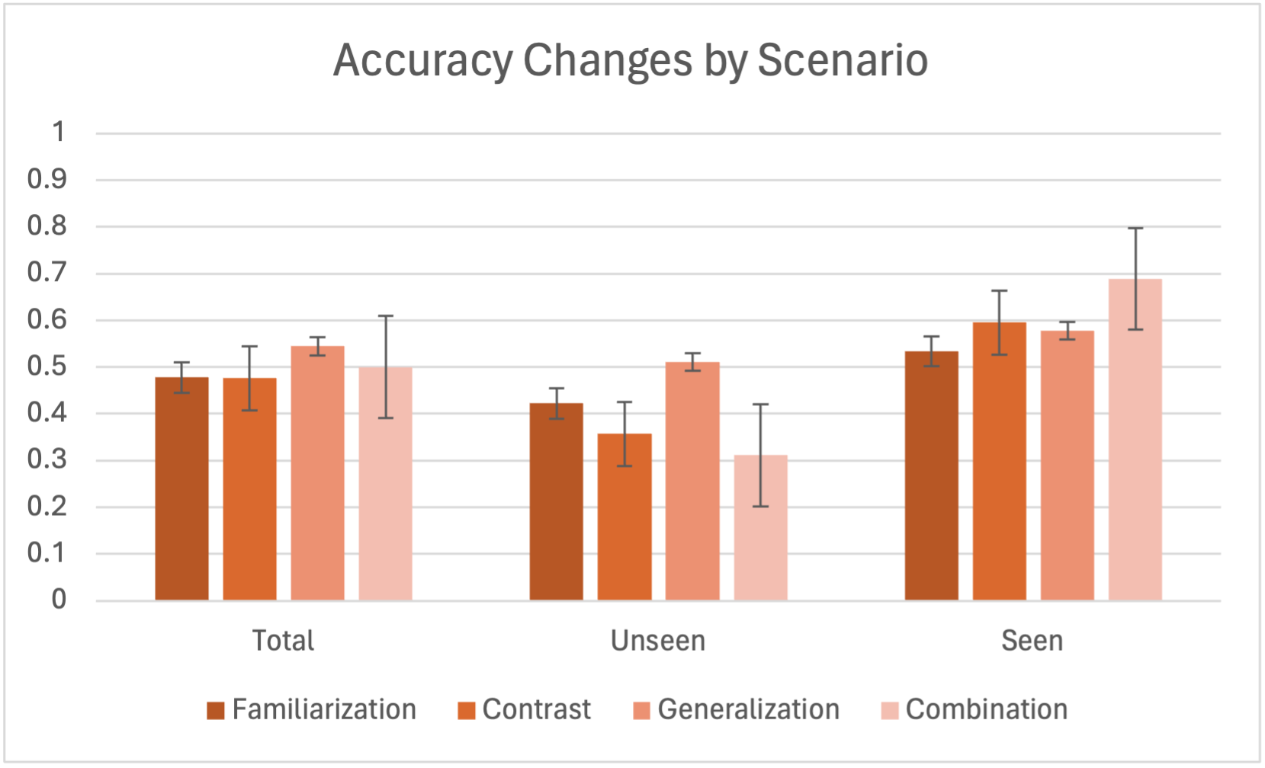
Overall
Hypothesis 1: Using the prescribed steps of variation theory will improve users’ ability to predict an agent’s behavior, particularly in unseen environments.
Notes:
For hypothesis 1, I was expecting to see an overall improvement of accuracy when using variation theory steps. For unseen scenarios, I would have expected an even greater improvement of accuracy.
To answer whether Hypothesis 1 is true, first I assessed the users accuracy at predicting agent behavior. Overall, across all scenarios, there were minor increases over the baseline familiarization but none were statistically significant over the 60 participants.
Even though these results were not statistically significant, it does map to the expected results of variation theory and suggests the promise of the use of contrast, generalization, and the combined variation theory steps which should be investigated in future with a larger sample to determine their significance.

Slide 29
Unseen Scenarios
Hypothesis 1: Using the prescribed steps of variation theory will improve users’ ability to predict an agent’s behavior, particularly in unseen environments.
Notes:
But in light of hypothesis 1, the results from unseen scenarios are unexpected.
In the unseen scenarios, the use of contrast in fact lowers accuracy (contrary to my prior study [2]) by 6%. The use of the prescribed steps of variation theory in combination in fact decreased it to the lowest amount of any of the conditions:11% lower than familiarization.
Generalization breaks this downward trend by increasing over familiarization by 9%.
These results are not statistically significant and do come with a very high variance, but are surprising.
As seen here, generalization should improve people’s mental models in unseen scenarios by forcing them to generalize the model to a completely new situation [1]. However, I would have predicted contrast and the use of the combined steps (which included the same generalization video) to also improve people’s mental model in unseen scenarios. One possible reason for this is different policies of motion may require differences in structuring to benefit from variation theory, causing very different amounts of learning in the same condition, as I will discuss in the next section.

Slide 30
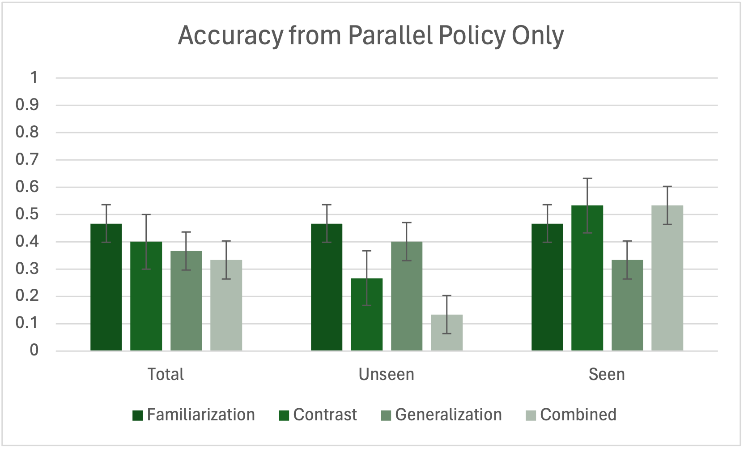
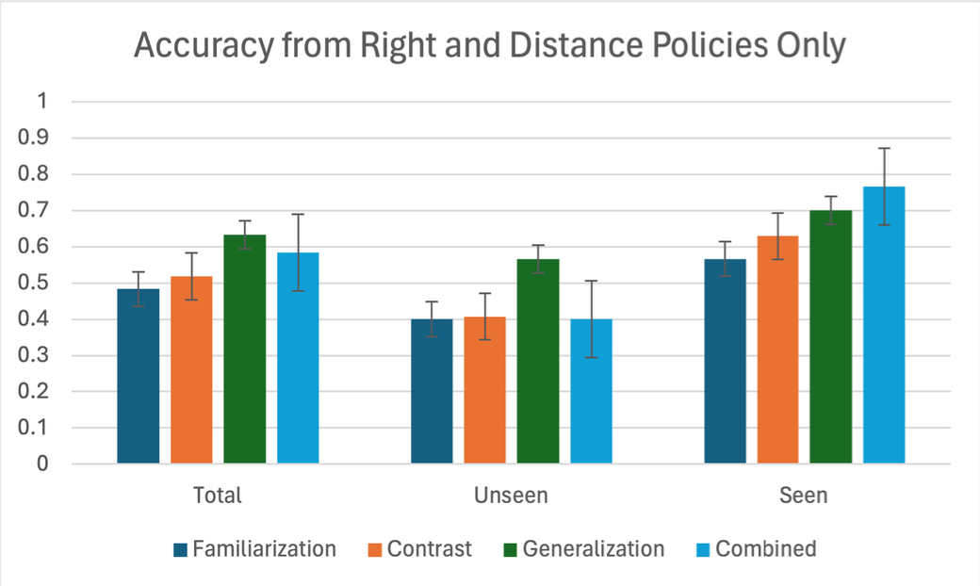
Policy-based Changes
Notes:
Is it possible that the policy matters for the use of variation theory? In analyzing the results, I noticed significant differences between the combined FastRight/SocialDistance groups and the Parallel groups.
Interestingly, even some of the differences in condition predictability appear to be policy-dependent. These differences were present in both the qualitative and the quantitative measures across both seen and unseen scenarios between FastRight/SocialDistance and the Parallel groups,

Slide 31
Parallel Policy
Notes:
If we isolate the parallel policy, we see decreases with the use of steps of variation theory across all scenarios, but particularly the unseen scenarios. In the parallel policy, accuracy steadily decreased when all scenarios were examined, although this was not statistically significant. In the unseen environments, however, this was especially pronounced and the dramatic 34% decrease between familiarization and the combined condition was statistically significant. This goes opposite to what Hypothesis 1 would have predicted.

Slide 32
Right and SocialDistance Policies
Notes:
Meanwhile, when separated from the parallel policy, the other two policies form a pattern that is much closer to what was postulated. There are increases for contrast, generalization, and the combined condition both in total and seen scenarios. In the unseen scenarios for contrast and total there is no strong effect, so I find no support for that piece of H1 under these circumstances. However, there is a strong effect for the use of generalization improving learning of unseen scenarios, which does support H1. This supports the use of variation theory as presented in this paper with policies that fall within the boundary space of users pre-conceived notions of considerations for movement.

Slide 33
Why did this happen?
Hypothesis 2: Policies that deviate from typical human driving behaviors will be harder for people to learn.
Notes:
From the qualitative responses, I suspect that the issue is that the critical aspect of the other policies (which lane or how much distance) were immediately discernible to the users (coming up in 87% of responses) while the critical aspect of the parallel policy was only discerned by 1 respondent out of 20, who noted that it ”prioritized peripheral space over forward space”.
As staying close to the closest car in the x-direction which is not in the same lane as you (to avoid collisions) is not a facet that people consider in driving, while which lane to be in and how much room to leave between cars are, the analogical transfer that people were using of their experience of driving may have impeded their ability to learn this new policy.
This supports hypothesis 2: policies that deviate from typical human driving behaviors will be harder for people to learn.
Variation theory requires that the critical aspect to learn be grasped in the familiarization step before any other steps can be effective [1]. In my prior study [2], most people would have had no expectations about how a robot arm should move (other than a tenous connection to their own arm, greatly complicated by the robot’s seven joints compared to our main three). This would have made those policies fall under the same umbrella as the SocialDistance and FastRight policies, making the trends similar.
As a result, one explanation for the learning changes observed in these two groups of policies is that the first step of variation theory was incomplete due to a lack of time or correct structure to discern the critical aspect, and thus the benefits of the other steps were unable to be fully unlocked.

Slide 34
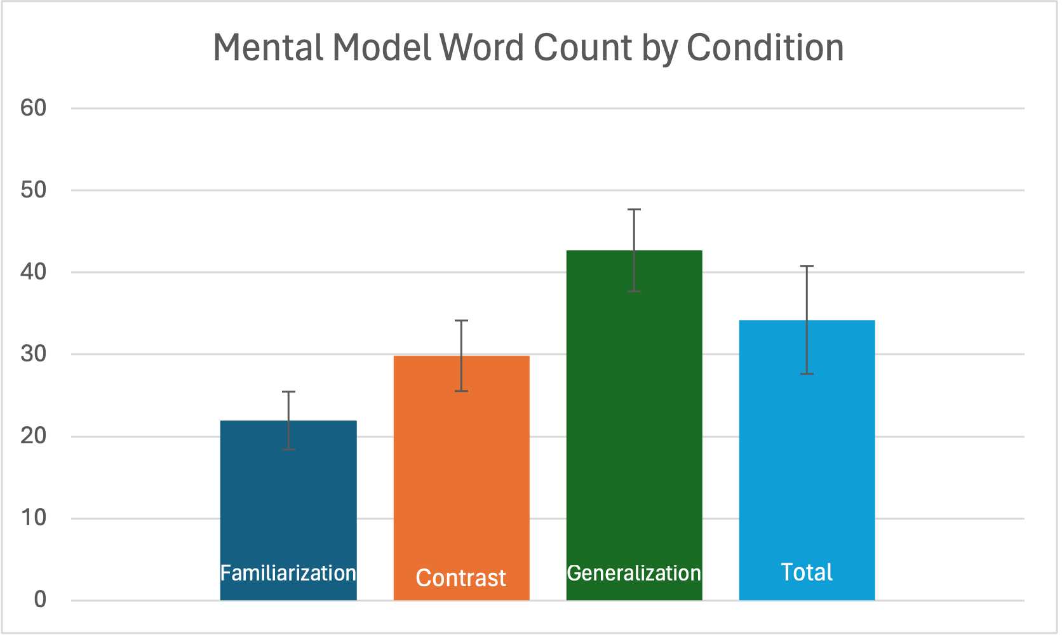
Mental Model Complexity
[22] P. L. Curseu and D. Rus, “The cognitive complexity of groups. A critical look at team cognition research.,” Cogni ̧tie Creier Comportament, vol. 9, no. 4, pp. 681–710, 2005. Place: Romania Publisher: Romanian Assn for Cognitive Science.
[23] S. Uitdewilligen, M. J. Waller, R. A. Roe, and P. Bollen, “The effects of team mental model complexity on team information search and performance trajectories,” Group & Organization Management, vol. 48, no. 3, pp. 755–789, 2023.
Notes:
Another aspect to test whether the use of variation theory improved mental models is if it increased complexity of people’s mental model. Curseu et al. define low cognitive complexity as having few rules for interpreting information in ”The cognitive complexity of groups: A critical look at team cognition research” [22]. Uitdewilligen et al., in their paper ”The Effects of Team Mental Model Complexity on Team Information Search and Performance Trajectories” note ”mental model complexity may be significantly important above and beyond similarity and accuracy”.
In this study, the person’s mental model is represented by their qualitative response to the question: ”Write a few sentences describing how you think the car decides to move based on what you have seen so far.” Their response serves as a compressed version of the heuristic they use to predict the policy’s behavior, and the length of that response can be a proxy for the complexity of their understanding of the underlying reward function.
When analyzing the results, there was an increase in the mean word count over familiarization for all other conditions, which was statistically significant for the generalization group. One possible explanation for this is that the contrast step added to people’s mental model by presenting alternative options that should be screened out of the model. The generalization step would logically expand users’ mental model as they would have built up an initial mental model after being shown the first few videos that may have been contradicted when shown the generalization video, leading to a building up and generalization of their mental model to a broader range of new scenarios.

Slide 35
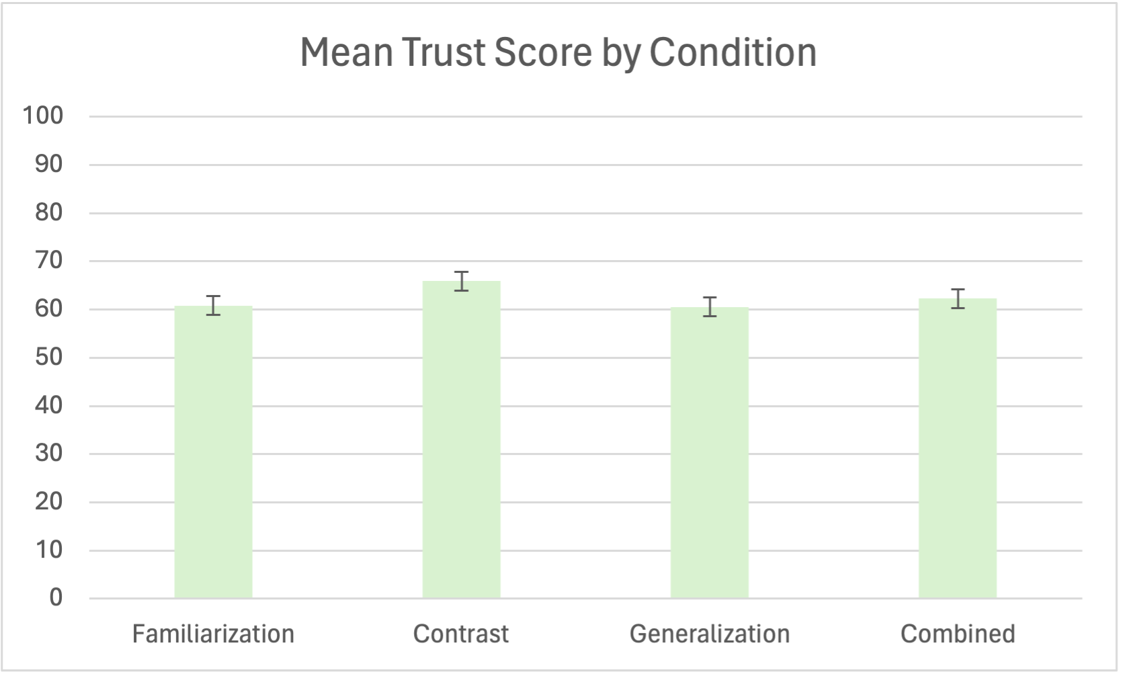
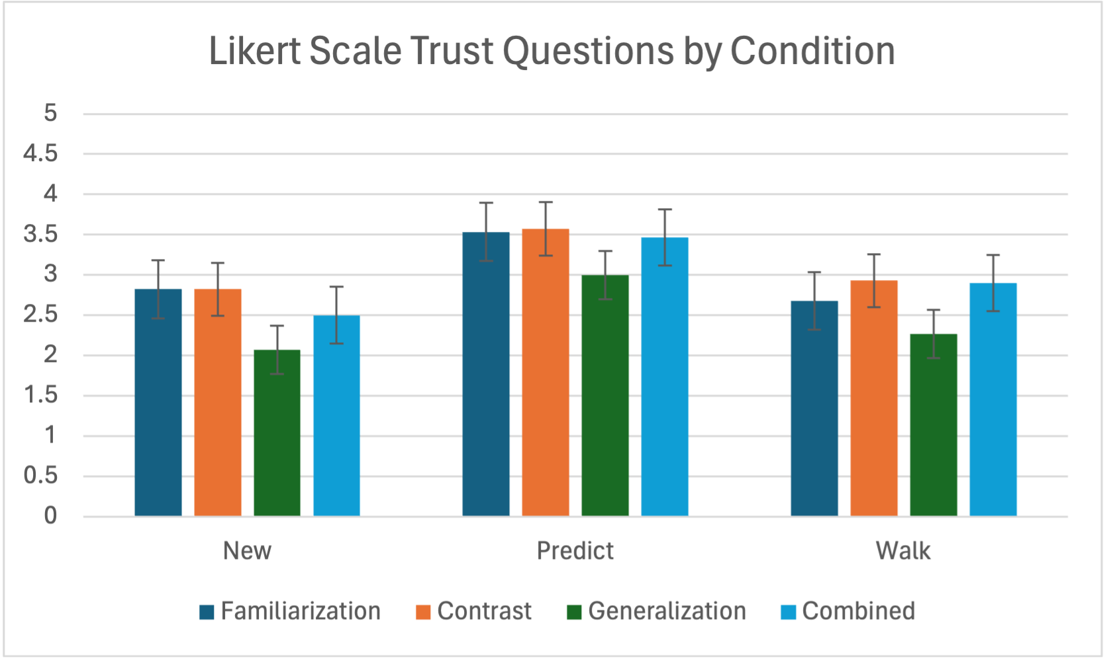
Trust
Hypothesis 3: Participants trained using the prescribed steps of variation theory will have a higher trust in the agent.
[21] K. Schaefer, The Perception And Measurement Of Human-robot Trust. PhD thesis, University of Central Florida, Aug. 2013.
Notes:
Does the use of variation theory improve people’s trust in the agent?
Participants were asked both explicit Likert scale questions about things like if they would trust the car in a new situation, or to walk behind it, and also to fill out a sequence of questions from Schaefer [15] relating to trust in automation, which combined to form a trust score.
The mean trust score of the contrast condition was significantly higher than the familiarization condition (increasing it by 5.1%), though the other conditions did increase but not significantly.
Though there were no statistically significant changes in the mean trust scores by question, question 8 was indicative of response trends. Q8: What % of the time will this car be predictable? In the responses to this question, the contrast condition is significantly higher than all others at 72% compared to familiarization’s 55%. This is surprising as the contrast condition either was on the same level as familiarization for accuracy or was lower than familiarization.
The Likert scale questions asking people explicitly about trust showed no effect from a statistical significance point of view. There is a visual trend that can be seen towards trust in the generalization condition being lower. This is interesting as generalization was one of the highest accuracy levels,.
Contrary to H3, which stated that ”Participants trained using the prescribed steps of variation theory will have a higher trust in the agent,” improving people’s ability to predict does not seem to be what improves trust in the agent. Rather, one possible explanation is that people become less confident in knowing what the system is doing as their own mental model expands and shows breakdowns in their prior mental models. This leads to eliminating over trust. The mismatch between contrast’s perceived prediction capacity and the true prediction capacity is a real danger to over trusting the system. Care should be exercised when teaching using these techniques to not lead to overconfidence.

Slide 36
Limitations
Lack of statistical significance
Confusing camera position in the contrast condition agent behaviors across environments
Learning fatigue
Issues with online participants
Variation theory limits
[16] S. Booth, S. Sharma, S. Chung, J. Shah, and E. L. Glassman, “Revisiting human-robot teaching and learning through the lens of human concept learning,” in Proceedings of the 2022 ACM/IEEE International Conference on Human-Robot Interaction, HRI ’22, p. 147–156, IEEE Press, 2022.
Notes:
Let’s cover some of the limitations of this study:
The lack of statistical significance could be caused by two things: the limited sample size of participants as well as the policy-balancing plan which greatly increased variance. If I were to run this study again, I would separate out the policy-based questions from the improvements to each step of variation theory to test only one element at a time.
Another issue of the study is that the camera moved centered on the car, meaning that people exposed to the contrast condition were, though technically looking at the same environment, not looking at aligned representations of that environment. This may have made it difficult to glean the information that contrast is supposed to help learn as they were unable to tell that the environment was being held constant. This may also help explain the surprising results of contrast in unseen situations. It also relates to the idea of structural alignment, presented as necessary in Booth et al.’s work on variation theory and analogical transfer [16], as the representations must be structured similarly to be analogous to one another for easier learning from difference.
Another possible issue is that as different agents were trained with the same reward function, but in different environments, it is a possibility that they converged to different policies and therefore would not be appropriate for the use of demonstrating the same agent behavior in a new environment.
One potential issue in this study was the lack of time to adapt to different types of learning in the combined condition. People may have experienced learning fatigue from constantly needing to adapt to a different kind of video (familiarization, contrast, generalization) every 30 seconds in the combined condition. By showing more videos, people would have time to spend time in each step of variation theory. To compensate for this and to keep people’s attention, shorter videos should be used that focus on moments that would break current conceptual model.
Finally, there were also some issues with online participants - specifically, certain participants, based on the time taken to complete the survey, could not possibly have watched the entirety of the training and testing videos. This makes the learning that these few individuals did be somewhat suspect.

Slide 37
Variation Theory Limits
Policies must be visibly different
Salient demonstrations aren’t necessarily the same across policies
Notes:
There are also some limits that must be pointed out for the use of variation theory in predicting policies.
Policies that are not very visibly different are not good candidates for this method.
One example of this is testing scenario 4, which had the worst results across all conditions as shown in Table 2. This is perhaps due to the bottom two videos sharing a behavior for much of the video’s runtime due to the two policies goals being coincidentally aligned (the lane with the most space was the rightmost lane), only separating in behavior at the end after people may have already made up their mind.
This expresses a challenge for the designer of a variation theory intervention: the most salient parts of the video are not necessarily the same across all policies, which is important to consider when creating a demonstration for multiple policies.

Slide 38
Future Work
Run a larger study
      Test analogical transfer separately
      Limit over/under trust from intervention
      Correct people’s mental model individually
Notes:
One piece of future work is to run this as a larger study to be able to see statistically significant results.
Another element of future work is to systematically test out the effects of structured analogical transfer theory on learning agent behavior by testing the effect of different representations in the contrast intervention, one of which could be a fixed camera on the environment rather than the car.
One more element that should be explored in future studies is to determine how to limit over/under trust developed while using these teaching interventions so as to reach calibrated trust.
In my future research, I hope to use the steps from this study to generate a base model for human-robot understanding and then for each user, use the robot to determine gaps in their understanding that the robot can then attempt to correct or adapt to.

Slide 39
Conclusions
Overall, not statistically significant accuracy changes
Policy-dependent responses
Variation theory leads to more complex mental models
Trust not directly tied to predictability
[5] J. D. Lee and K. A. See, “Trust in automation: Designing for appropriate reliance,” Human Factors, vol. 46, no. 1, pp. 50–80, 2004. PMID: 15151155.
Notes:
There were not statistically significant results for accuracy changes to people’s mental models overall. However, it appears that this may be policy-dependent.. My theory for why this pattern occurred is that the parallel policy was challenging to learn without familiarization since the critical aspect had not yet been identified. Therefore, in cases where the critical feature to be determined is not yet in the established space of people’s mental models, it may be important to provide more time for familiarization and structure examples to break established mental models.
However, there is evidence in this study for people generating models of increasing complexity when using variation theory which might allow for the building of more accurate conceptual models of the robot.
One interesting result is people’s trust is not directly tied to their ability to predict the behavior of the robot. The contrast condition significantly improved trust, even specifically increasing people’s belief that they could predict the agent’s motion, despite in this study not improving or even sometimes decreasing their actual ability to predict the behavior of the agent. Generalization had the opposite effect - despite improving people’s ability to predict the behavior of the agent, people trusted it less, perhaps due to the training breaking down their prior mental models, making people less overconfident. This mismatch between actual prediction ability and perceived prediction ability leads to the danger of over- or under-trust, which is detrimental to the use of the system according to Lee and See [5].

